Slide 1

Has the Women’s Super League (WSL) growth strategy been working? An analysis of the 2020/21 – 2023/24 seasons
By Uyi Erhabor

Slide 2
Executive Summary
Quality of the league in terms of average goals and average expected goals (xG) per game has remained consistent
Analysis of data available reveals no definitive trend of competitive balance in the WSL
Total xG and Total goals have been key drivers of attendances

Slide 3
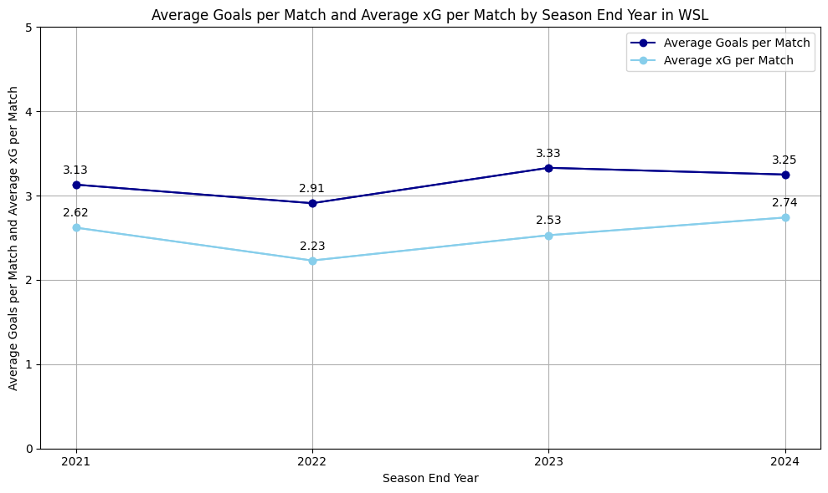
Minimal changes in average xG and average goals per match
Range in average goals per match (0.42)
Range in average xG per match (0.51)

Slide 4
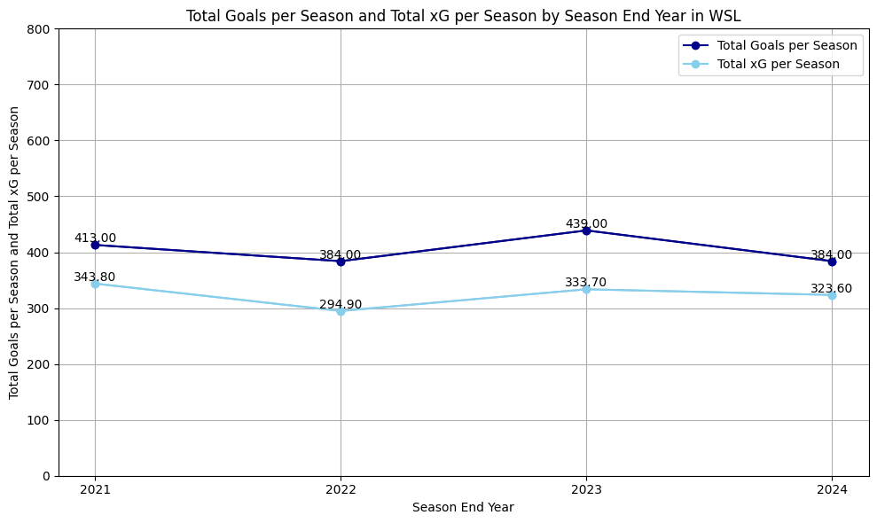
Noticeable variation in total goals and total xG
Range in total goals (55)
Range in total xG (48.90)

Slide 5
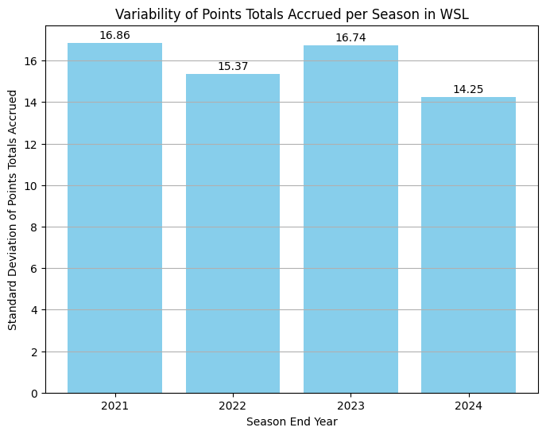
Is the WSL establishing its level of competitive balance ?

Slide 6
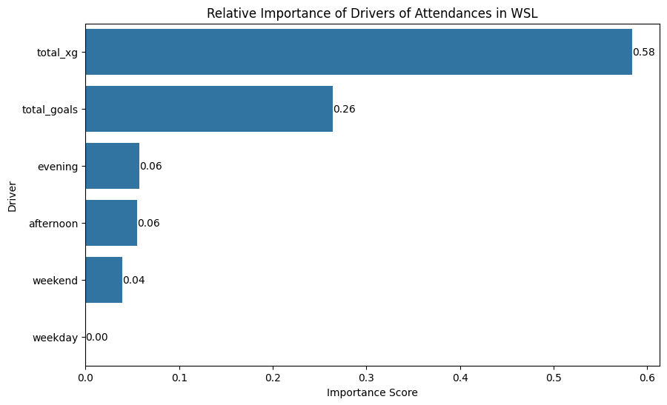
Key drivers of Attendance: Goals over everything?

Slide 7
Key findings
Quality of the league in terms of average goals and average expected goals (xG) per game has remained consistent
Analysis of data available reveals no definitive trend of competitive balance in the WSL
Total xG and Total goals have been key drivers of attendances

Slide 8
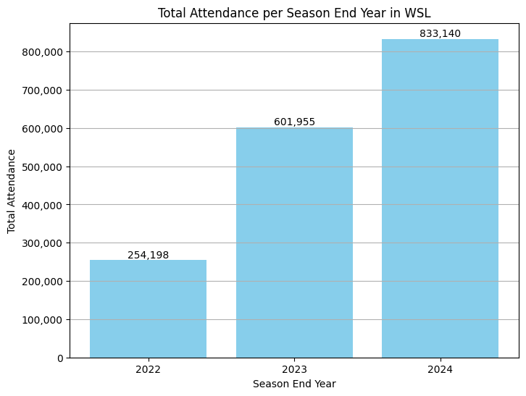
Season on Season Attendance Growth
Percentage Change in Total Attendance per season over period analysed (69.49%)

Slide 9
Has the WSL’s growth strategy been working over the past few years?
Analysis of trends in the quality of the league, competitive balance and drivers of attendance over at least the next 4 consecutive seasons (leveraging exhaustive data) should provide a more robust conclusion regarding the efficacy of the league’s growth strategy

Slide 10
Additional analysis to complement existing analysis
Competitive Balance: Points Distribution across seasons (calculated using the Gini coefficient measure of inequality)
Quality of league: Goals Distribution (xG and goals) across venues for each season, understand trends of high, medium and low-quality matches
Effect of additional drivers (different months of the year, referees and venues)

